Slide 1
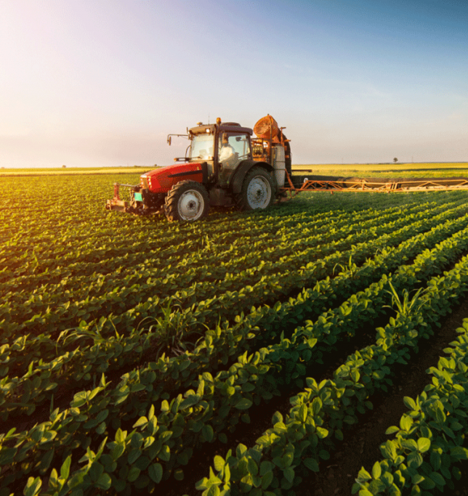
KAZAKHSTAN Wheat VS CANADIAN Wheat
Knayatov Yernar
Classic DS 1st year KBTU

Slide 2
1. Why Kazakhstan Is not An Agrarian Country? 2. Low Wheat Varieties of seed? 3. North Kazakhstan and Project Genesis

Slide 3
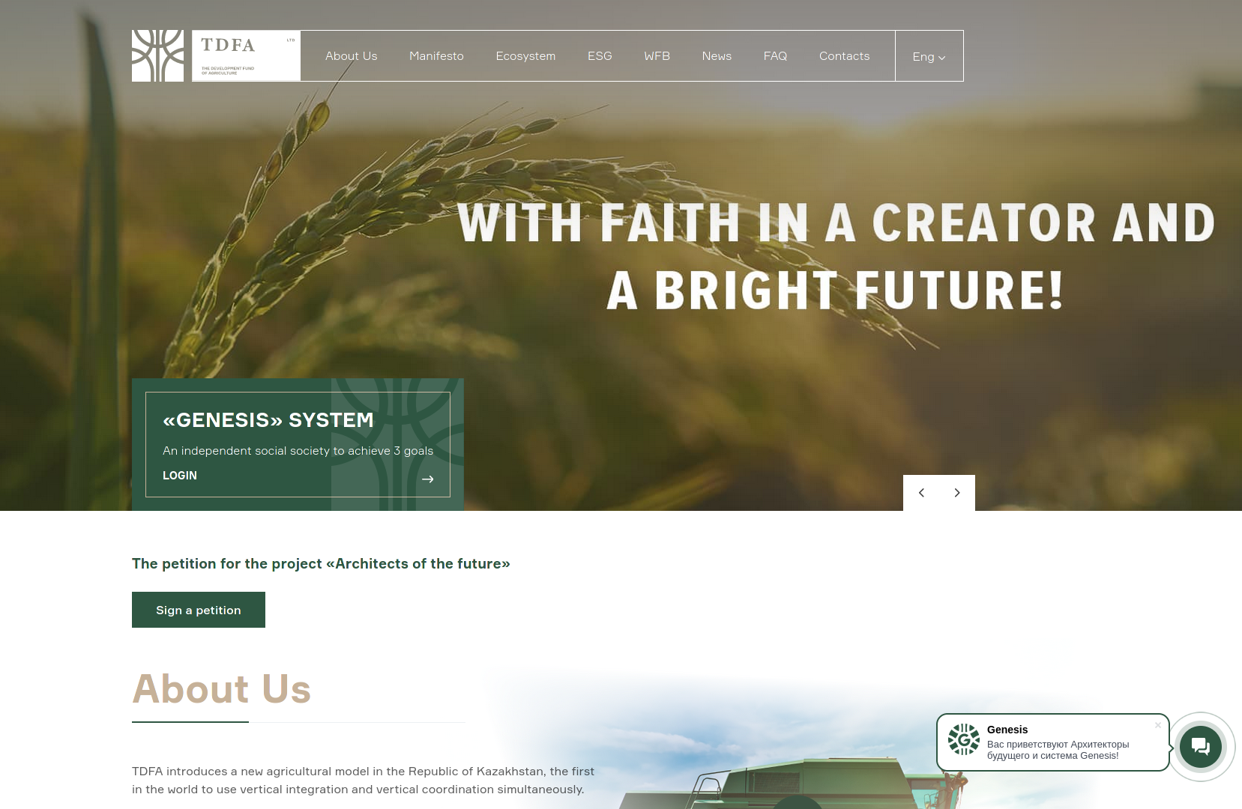

Slide 4
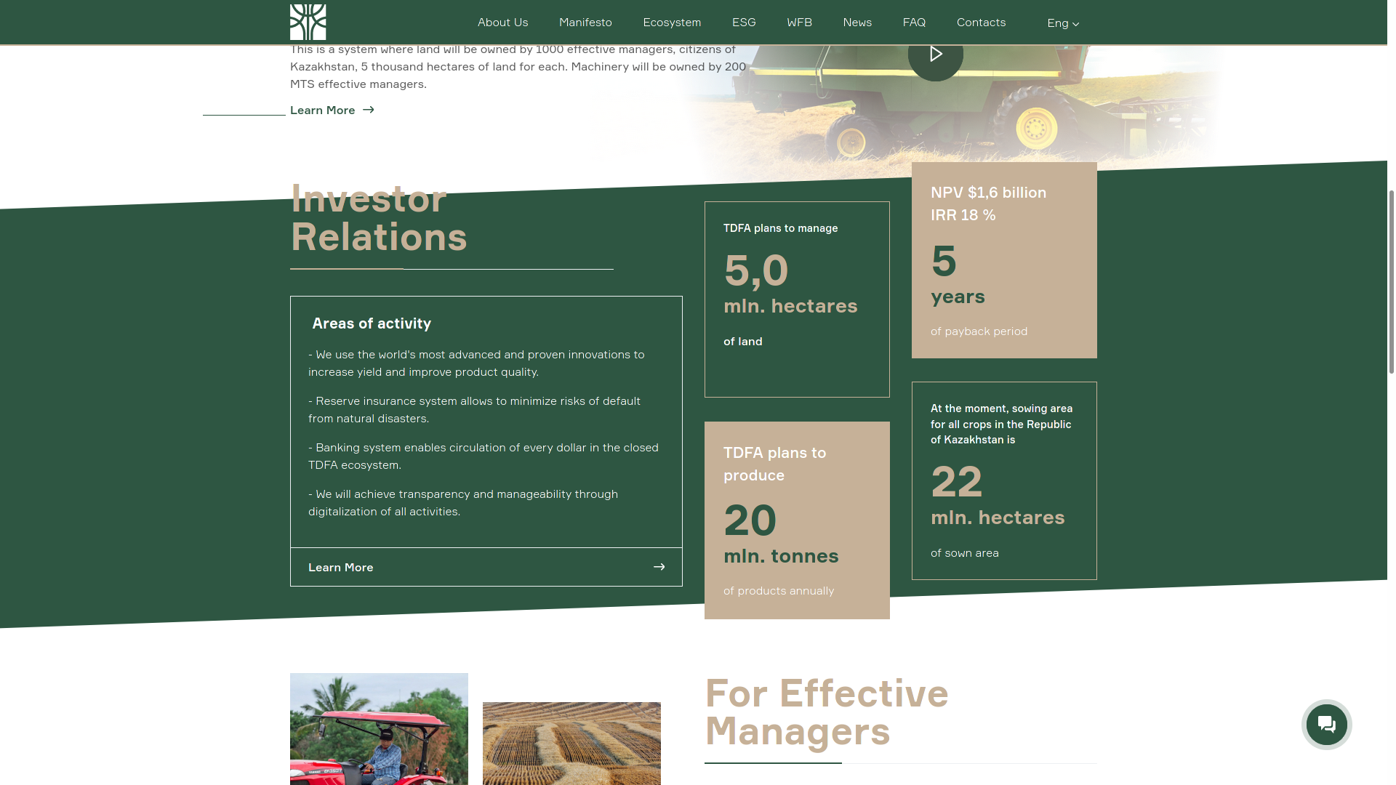

Slide 5
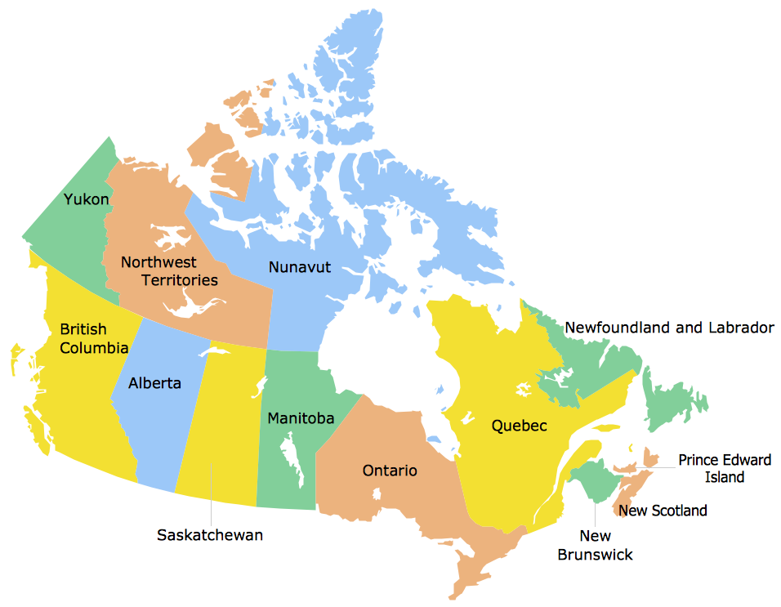
Saskatchewan

Slide 6
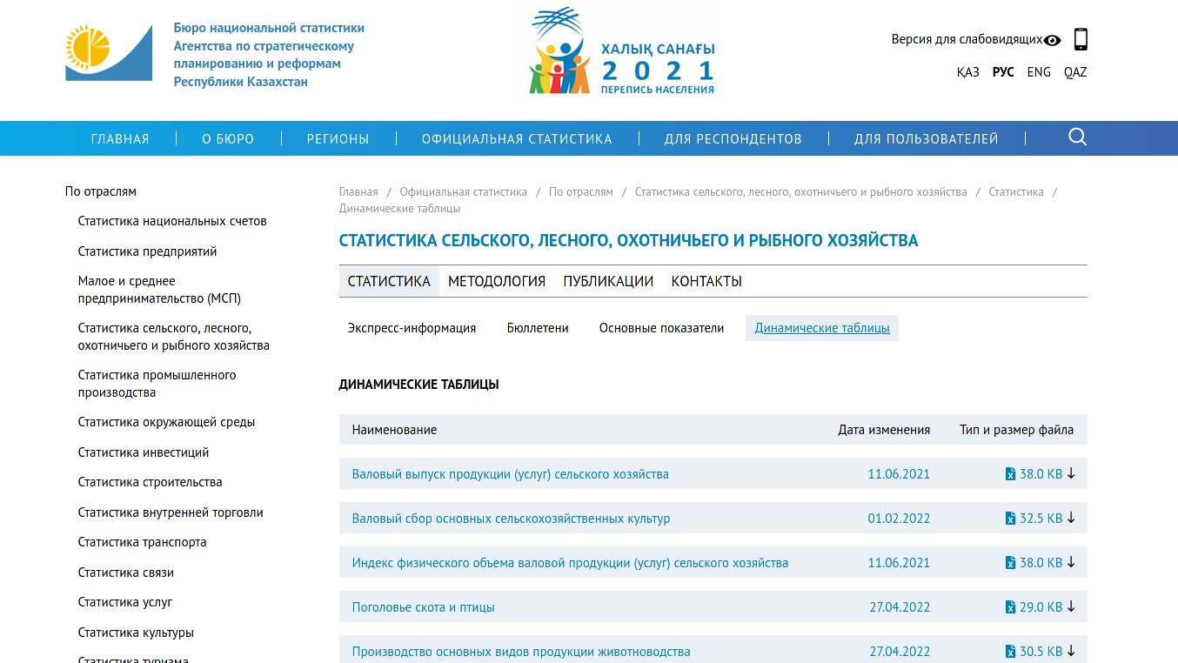
Data collected here

Slide 7
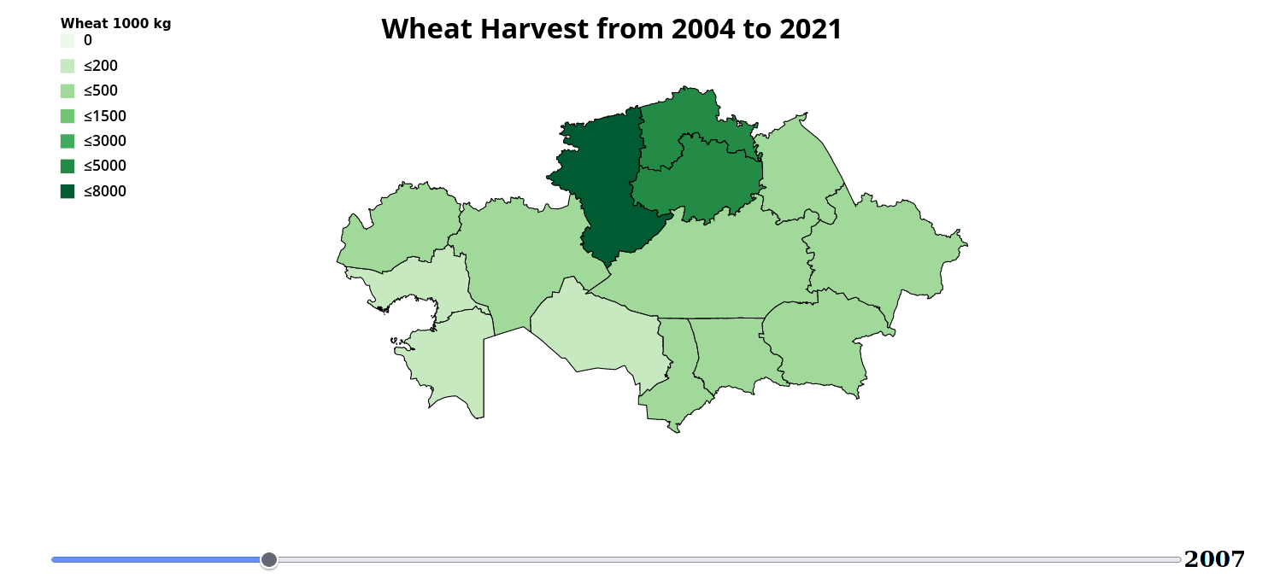

Slide 8
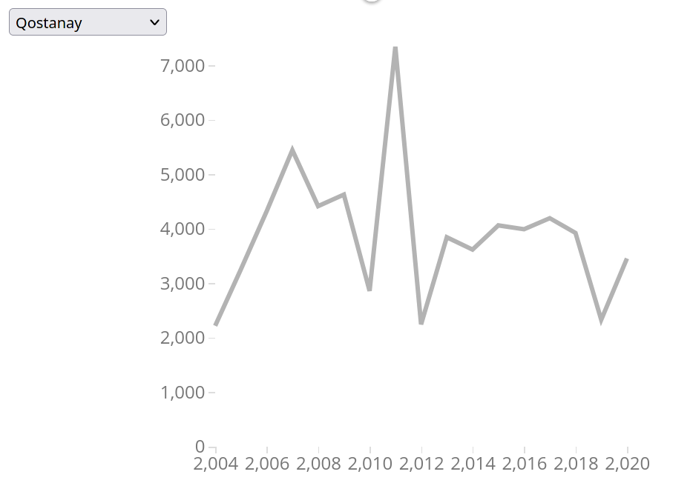
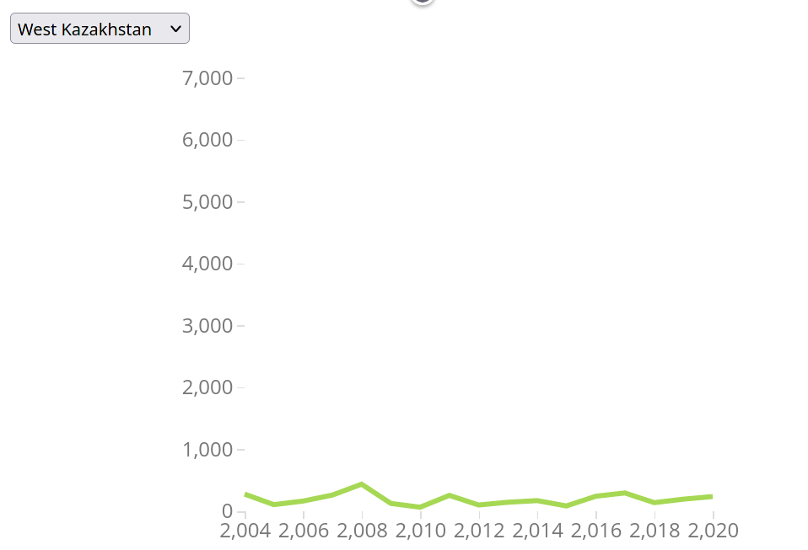
Regions' wheat crops per year

Slide 9
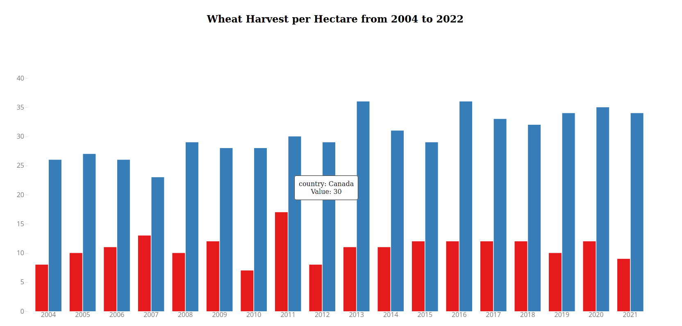

Slide 10
Conclusion
In conclusion, wheat seeds from Canada have high quality in reproduction, and a significant yield of 35-50 centners per hectare than our 10-14 centners per hectare. The nature of Saskatchewan is in the northern regions of our country with 95% similarity. In the end, I think the project will be approved by the government.

Slide 11


Links
https://genesis.kz/petition/
https://en.tdfa.kz/
https://d3-graph-gallery.com/
https://stat.gov.kz/

